Slide 2
AUTOMATIC INDUSTRIES
Your one stop solution for Precision & CNC Turned components / Parallel Keys / Woodruff keys / Fasteners / Sheet metal Components.

Slide 3
An insight …..
Incorporated more than six decades ago, our company code is one of measured strategic management, a desire to fulfill clients needs, a nexus of skilled workmanship and an infallible commitment to product and quality control.
Going forward with our experience, we are focused towards bringing a fresh perspective to trade, devoting ample time to developments, uncompromising quality standards with a mindset to build long term business relationships firmly entrenching our hold on the path to sustain excellence in the years to come …..
Creation of new concepts, ambitious expansion tempered by a desire to consolidate strengths, an amalgamation of versatilities, skills and technologies provide the backbone to our operations.

Slide 4
Our repertoire …..
Our offices & dispatches are conveniently set up in Vasai from where we host and operate our entire business empire catering to the complete needs of our buyers. Our manufacturing facilities in Vasai make it within our reach to connect, cater and fulfill our client needs & requirements.
With an ISO 14001:2015 & OHSAS 18001:2007 certification, and our vast experience , we have a stand out reputation in the manufacture, marketing and supply of quality industrial Components and related products for practically every application , satisfying practically every engineering need.
To say we are one of India’s foremost and premier Woodruff Key and Parallel key & Turn Components manufacturer and supplier.

Slide 5
Operations …
Keeping abreast with modernisation is the need of the hour and it is our keen eye for details which sets us apart from the others.
Our offices and factories are equipped with the very latest in modern means of communication to ensure regular networking with the manufacturing as well as marketing aspect.
Effective communication, follow ups, personal securitization, checking, ensuring correct labeling/tagging is done, correct vendor codes, cover notes – each of our team members play a pivotal role in our company ethos.
Our shipping department is well versed with all government policies, banking and import/export procedures, freight forwarding across the country from various ports be it for exports or imports.

Slide 6
Quality Control …
All our products confirm to the highest international standards – we have comprehensive quality checks … stringent quality control tests are conducted at every stage throughout the manufacturing process which helps us maintain the high quality standard we have set ourselves.
With the ISO 14001:2015 & OHSAS 18001:2007 certification, we ensure a complete adherence to set standards … right from recording of an enquiry, to quotation being sent, to orders being registered, to the process of manufacturing with thorough quality checks, to certification , to packing, to supply … we have a complete exhaustive system in place following of which is a standard norm non devisable.

Slide 7
Been there , done that . . . Now What ?
As we reach out to the new regime, we actively seek new clients and innovative partners who share our visions and ideals.
We accept the challenges the future may have to offer and constantly look to strengthen and augment our services to fulfill our clients needs.
Its not about the competition and what they can offer … performance matters ; making the right product, in the right quality, within the right time frame , in the right price , using the right raw materials and conducting and going about our business in the right manner is what we are all about.
Our commitment to our business is our forte and consistency has been a calling card for our company which is why our products find buyers in leading OEM’s, importers , business houses and high profile companies the world over ….. measuring up to our own benchmarks of high standards, we constantly pace ourselves !

Slide 8
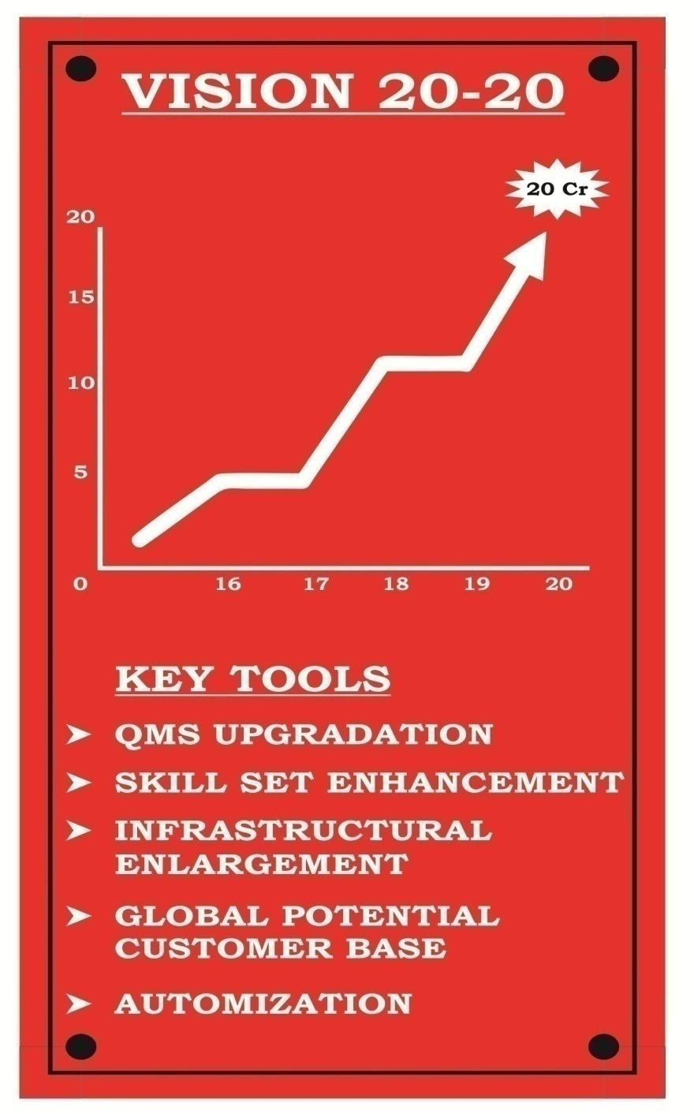
VISION

Slide 9
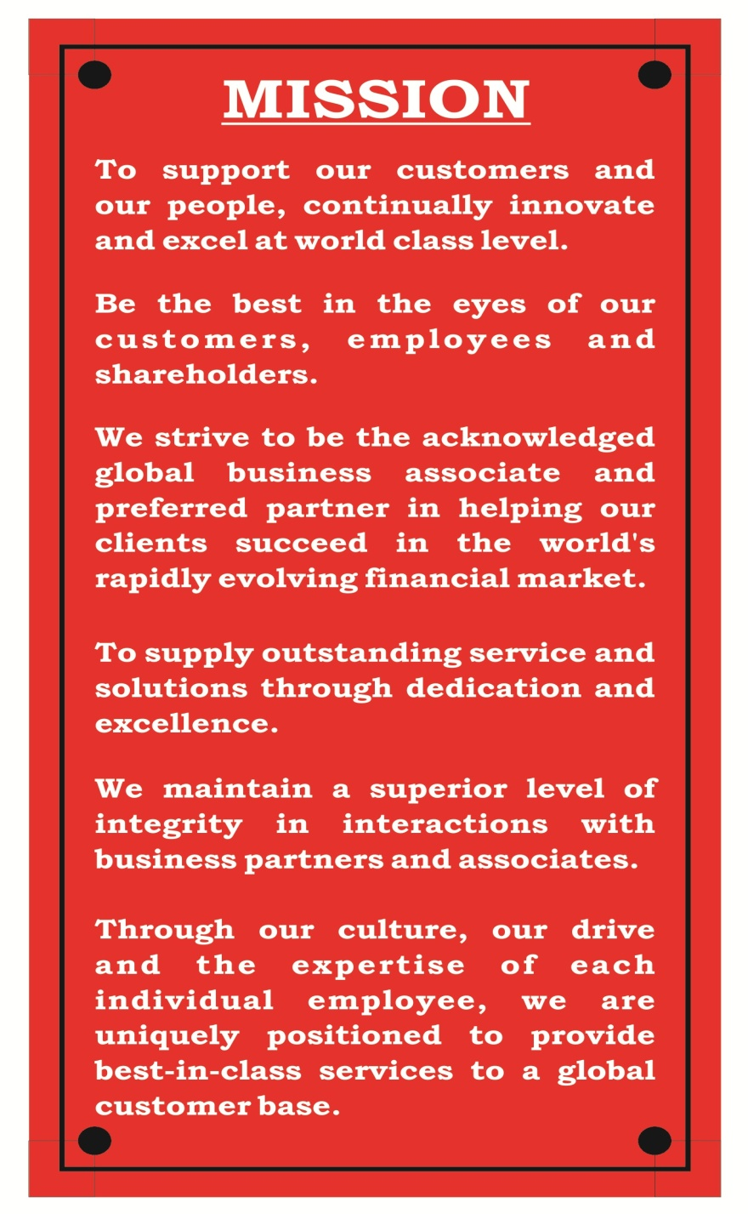
MISSION

